Slide 1


Slide 2


Slide 3
Set up
log onto Quest
ssh <netid>@login.quest.northwestern.edu # enter your netid password
Move to our classroom folder
cd /projects/e32680
Make your own subfolder if you don’t have one
mkdir <folder name>
cd ./<folder name> #navigate to your folder

Slide 4
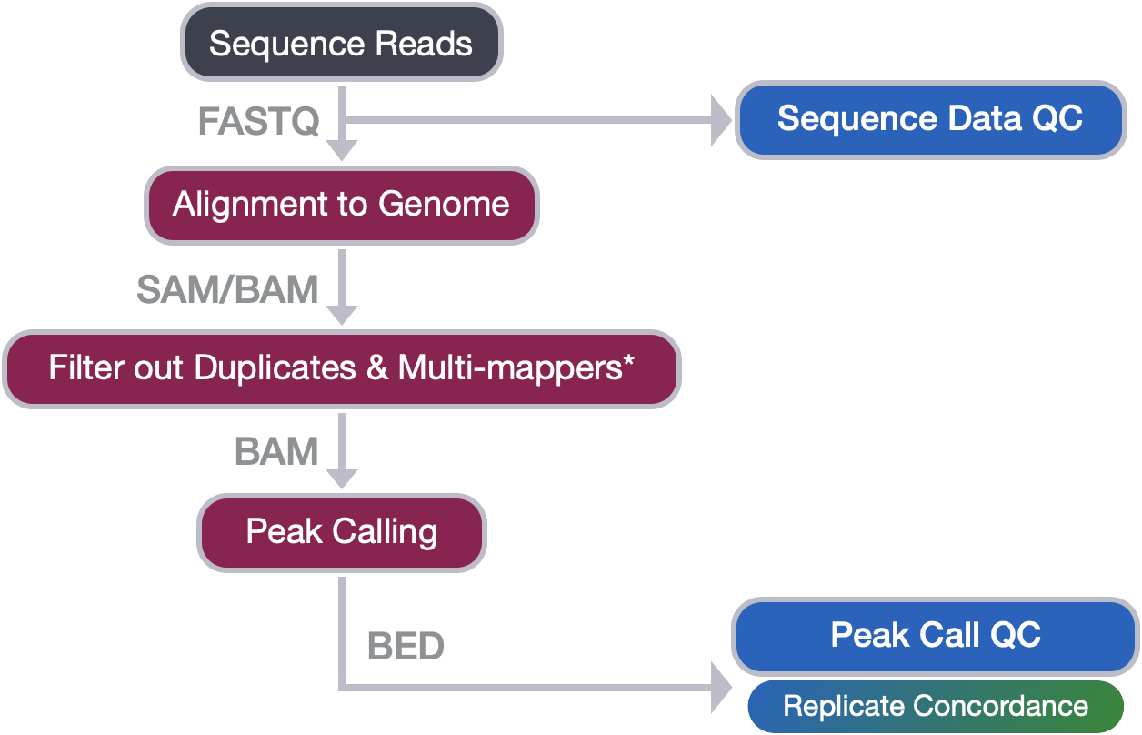
General ChIP-seq workflow

Slide 5
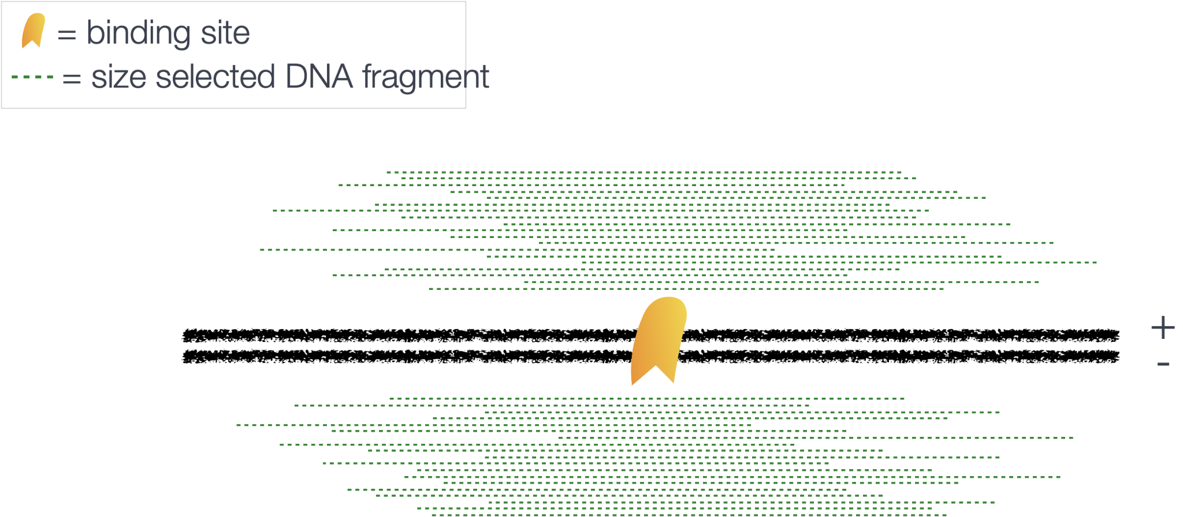
Bimodal nature of ChIP-seq data

Slide 6
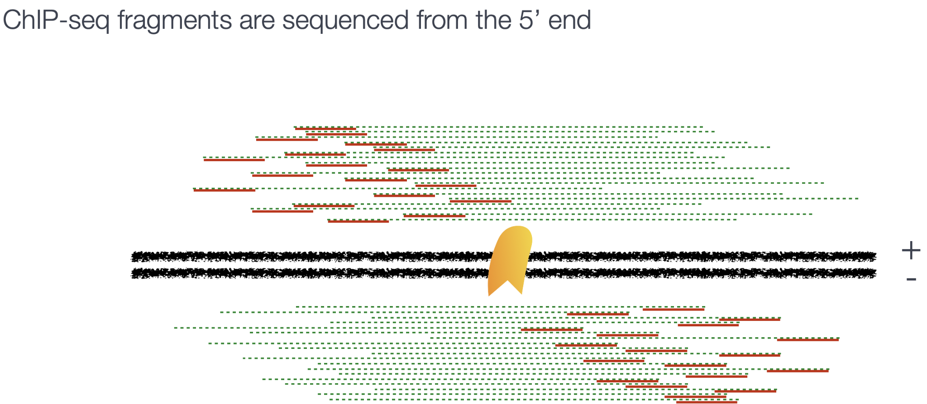
Bimodal nature of ChIP-seq data

Slide 7
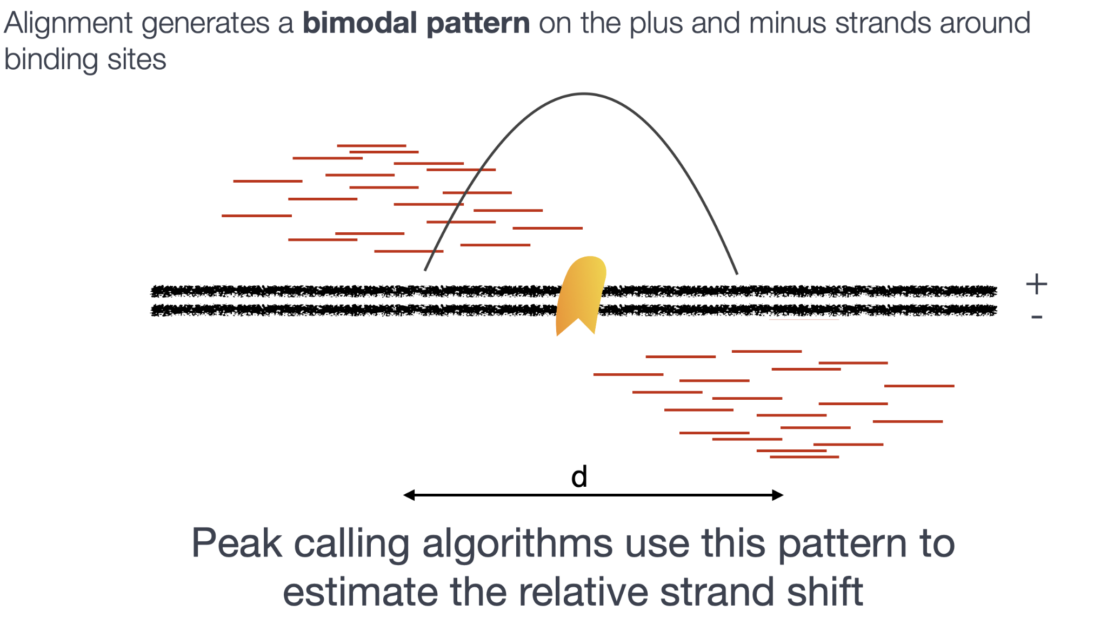
Bimodal nature of ChIP-seq data

Slide 8
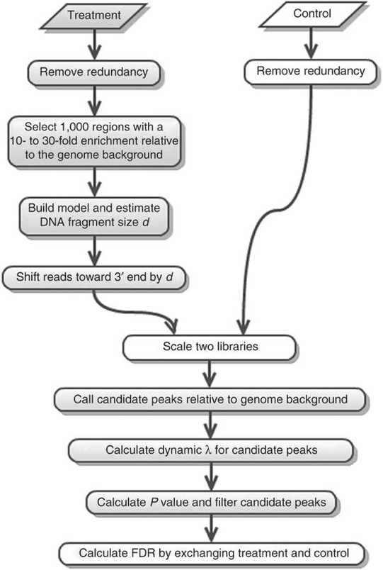
MACS workflow
Estimate the shift size
2. Calling peaks

Slide 9
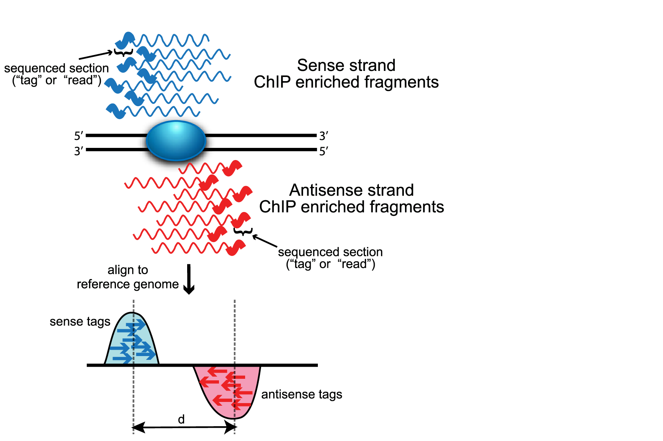
Modeling the shift size (d)
MACS searches for highly enriched regions across the genome (600bp window with 50-fold enrichment)
Randomly samples 1000 peaks
Estimates d (distance between the modes of the two peaks)
Wilbanks and Faccioti, PLoS One 2010

Slide 10
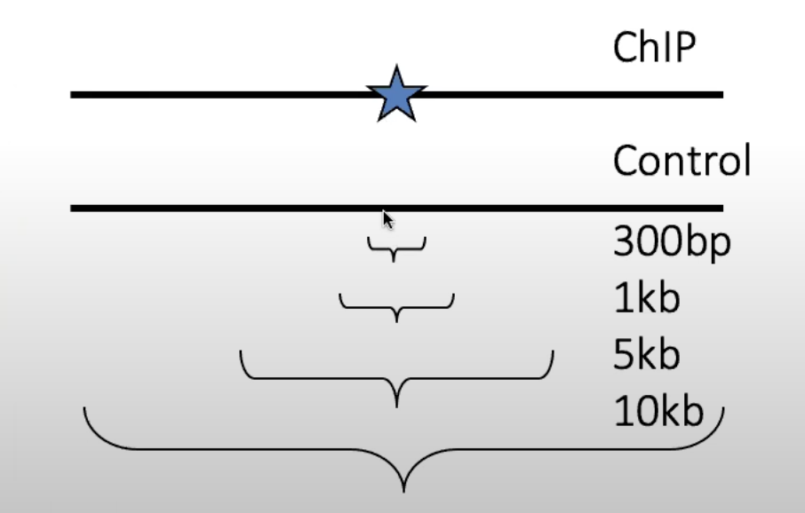
Peak calling
MACS models peak distribution using the Poisson distribution.
MACS computes λ(expected number of reads in a given window) for each candidate peaks.
A Poisson distribution p is computed to identify significant enrichment (p < 1e-5).
Estimate FDR using the Benjamini-Hochberg correction
Dynamic λlocal: control local bias

Slide 11
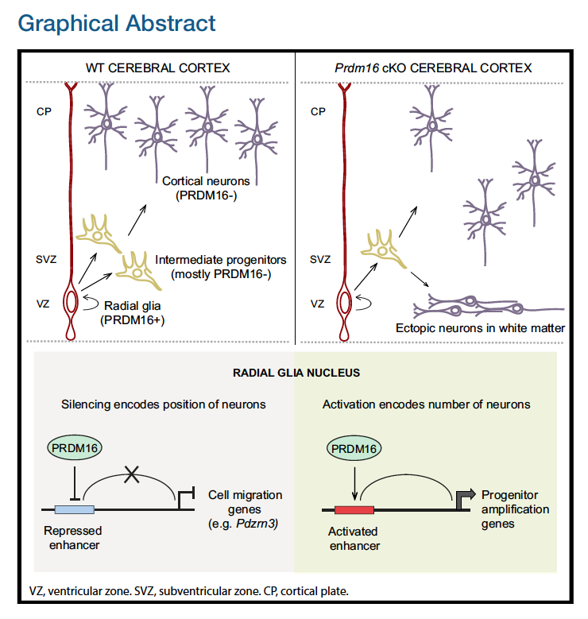
Experiment setup: identify and validate the targets and activities of PRDM16 using PRDM16 conditional knockout mice
Groups: WT and PRDM16 KO
2 replicates per group
Baizabal
Neuron 2018

Slide 12
Course folder setup
cd /projects/e32680/03_macspeakcalling_reference
#course folder
./00_fastq
#raw data (fastq) folder
./01_bam
#bam files folder
./scripts
#scripts folder

Slide 13
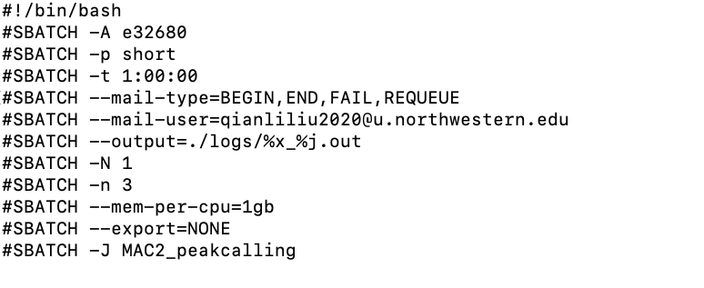
Sbatch commands

Slide 14
Running MACS2
macs2 callpeak -t ./wt_sample1_chip.bam \
-c ./wt_sample1_input.bam \
-f BAM -g mm \
-n wt_sample1 \
--outdir
-t: data file
-c: input control
-f: format -g ;mappable genome size
-n prefix string for output files
--outdir output directory

Slide 15
Running MACS2
cd ./<YourFolder>
#Navigate to your folder
cp /projects/e32680/03_macspeakcalling_reference/scripts/MACS2_1.sh .
#copy script to run MACS
nano MACS2_1.sh
#edit script
sbatch MACS2_1.sh
#run script

Slide 16
Check on jobs
squeue --me
# shows all running and pending jobs
sacct -X
# shows all jobs from today
sacct -X -S 040125
# shows all jobs from this month

Slide 17
MACS2 Output
_peaks.narrowPeak: BED6+4 format file which contains the peak locations together with peak summit, pvalue and qvalue
_peaks.xls: a tabular file which contains information about called peaks.
_summits.bed: The location in the peak with the highest fragment pileup. These are the predicted precise binding location and recommended to use for motif finding.
_model.R: an R script which you can use to produce a PDF image about the model based on your data and cross-correlation plot

Slide 18
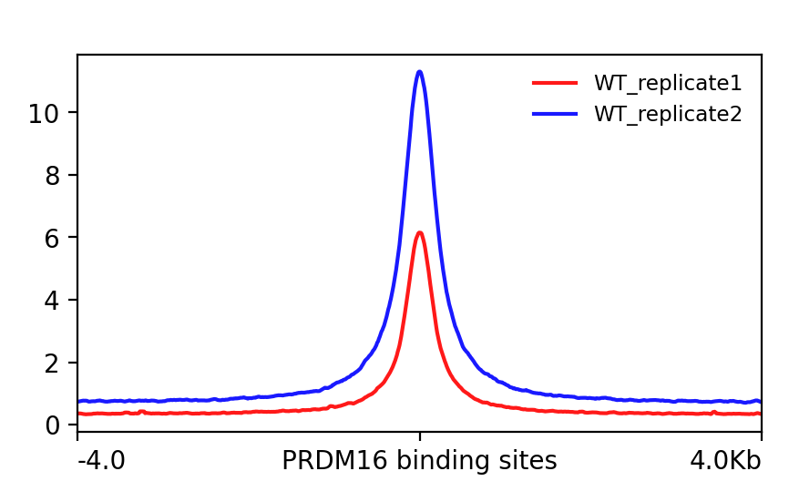
After peak calling
Finding overlapping peaks between replicates.
Bedtools intersect
Visualizing peaks using deepTools.

Slide 19
Finding overlapping peaks between replicates
bedtools intersect \
-wo -f 0.3 -r \ #
-a wt_sample1_peaks.narrowPeak \
-b wt_sample2_peaks.narrowPeak \
> <YourFolder>/wt_peaks_final.bed
-wo: Write the original A (file 1) and B (file 2) entries plus the number of base pairs of overlap between the two features.
-f: Minimum overlap required as a fraction of A.
-r: Require that the fraction overlap be reciprocal for A and B. (we require the overlap region being at least 30% in A and B)

Slide 20
Creating bigwig files for visualization
Module load deeptools/3.5.6
bamCoverage -b /projects/e32680/03_macspeakcalling_reference/01_bam
/WT_REP1.mLb.clN.sorted.bam \
-o <YourFolder>/wt_sample1_chip.bw \
--binSize 20

Slide 21
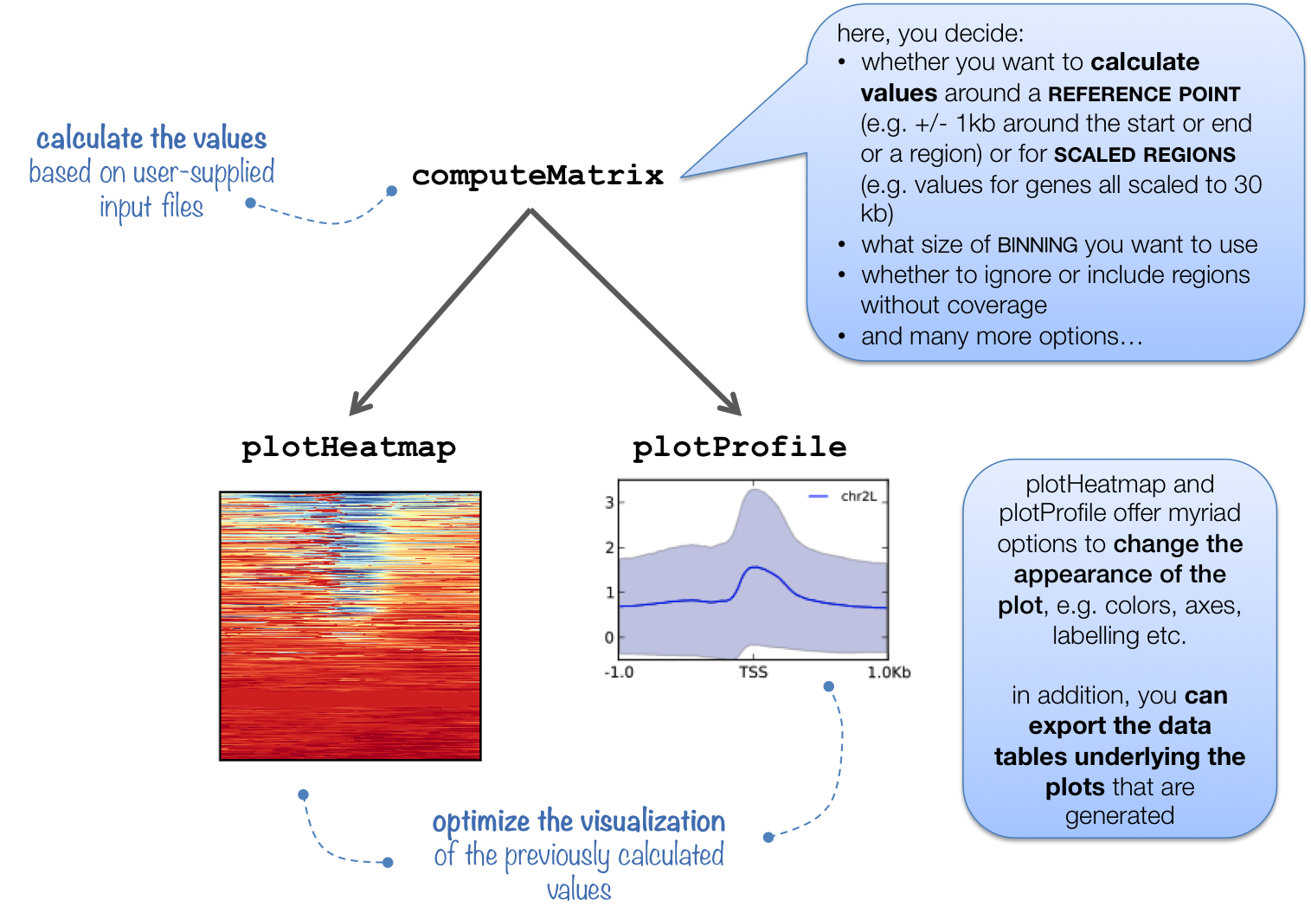
Evaluating signal in PRDM16 binding sites
https://deeptools.readthedocs.io/en/latest/

Slide 22
Compute matrix
computeMatrix reference-point --referencePoint center \
-b 4000 -a 4000 \
-R <YourFolder>/wt_peaks_final.bed \
-S <YourFolder>/wt_sample1_chip.bw <YourFolder>/wt_sample2_chip.bw \
--skipZeros -o <YourFolder>/wt_matrix.gz
reference-point: The reference point for plotting.
-b, a: Specify a window around the reference point
-R: The region file (we will use the WT replicate overlap BED file).
-S: The list of bigWig files
--skipZeros: Do not include regions with only scores of zero
-o: output file name

Slide 23
Drawing the profile plot
plotProfile -m ./wt_matrix.gz \
-out ./plot1_wt_replicates.png \
--regionsLabel "" \
--perGroup \
--colors red blue \
--samplesLabel "WT_replicate1" "WT_replicate2" \
--refPointLabel "PRDM16 binding sites"
-out: output file name
--regionsLabel: Labels for the regions plotted in the heatmap
--perGroup: The default is to plot all groups of regions by sample
--colors: List of colors to use for the plotted lines
--samplesLabel: Labels for the samples plotted
--refPointLabel: Label shown in the plot for the reference-point.

Slide 25
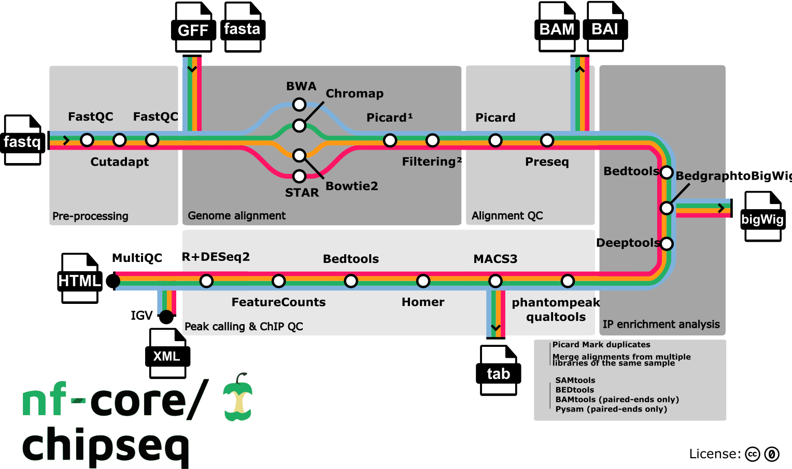
Running MACS with Nextflow
https://nf-co.re/chipseq/2.0.0/

